Slide 1
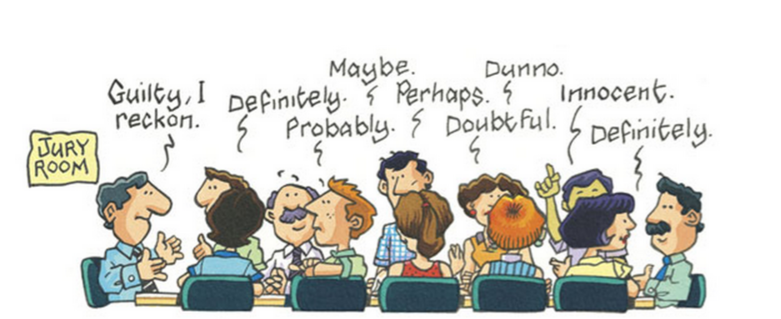
The jury system

Slide 2
Overview
The role of juries, and factors that influence their composition
Strengths and weaknesses of the jury system
Reforms and alternatives to the jury system

Slide 3
The Role of the Jury
Once lawyers have presented their evidence and arguments, the trial judge will explain to the jury their role. The role of the jury in criminal and civil cases is similar. Essentially, the jury is a fact-finding body that must:
listen to all the evidence presented by both parties
consider the evidence
reach a decision based on the evidence.
The jury’s final decision is based on its understanding and interpretation of the facts of the case. The judge will direct the jury on:
the burden of proof
the standard of proof
the law applicable to the case
a summary of the key elements, including any defence claimed.

Slide 4
Jury in a criminal trial
Used in all trials in the County and Supreme courts where the accused has pleaded not guilty
Not used in the Magistrates’ Court, in appeal cases or when the accused pleads guilty
Jury of 12 will decide whether the accused is either guilty or not guilty beyond reasonable doubt
Must be unanimous verdict. Can be majority verdict after six hours (but not in cases of murder, treason and other serious indictable offences)

Slide 5
Jury in a civil trial
Trials in the County and Supreme courts when either party or the judge requests a jury
Not used in Magistrates’ Court, in appeal cases or when no party or the judge requests it
Jury of six will decide which party is in the wrong/right on the balance of probabilities
Can be majority verdict
Can decide on amount of damages if plaintiff successful

Slide 6
Composition of juries
Number of jurors
12 jurors in criminal trial – 15 can be empanelled for longer trials (but only 12 deliberate)
6 jurors in civil trial – 8 can be empanelled for longer trials (but only 6 deliberate)
Selection of jurors
Randomly selected for jury duty from the electoral roll
Questionnaire sent to a list of prospective jurors
Persons can be (Juries Act 2000):
disqualified from serving as a juror
ineligible to serve as a juror
excused for good reason
If eligible, prospective jurors will be sent a summons requiring them to attend court, where they may be selected to sit on a jury

Slide 7
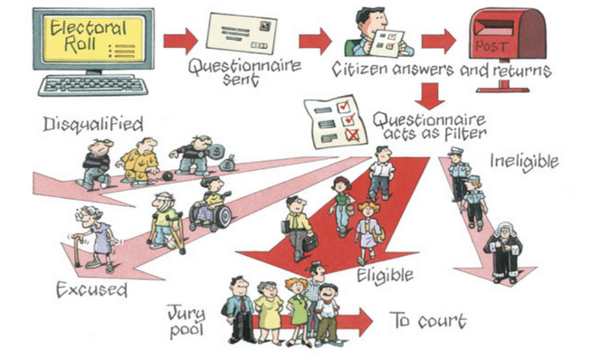
Pre-Selection Process

Slide 8
Composition of juries – disqualified
Something they did in the past. Examples include:
Person convicted of treason or one or more indictable offences and sentenced to imprisonment or a period of detention under a hospital security order for more than three years
Person who within the last 10 years has been sentenced to imprisonment or a period of detention under a hospital security order for three months or more (excluding suspended sentence)
Person sentenced to imprisonment or a period of detention under a hospital security order for less than three months
Person who has been charged with an indictable offence and is released on bail in respect of that offence
Person who is remanded in custody in respect of an alleged offence
Person who has been declared bankrupt and has not obtained a discharge
See page 549 for full list

Slide 9
Composition of juries – ineligible
Occupation or inability to comprehend task. Examples include:
Person who is or within the last 10 years has been:
the governor
a judge, magistrate or holder of any other judicial office
a bail justice
an Australian lawyer
a member of the police force
a person employed or engaged in the public sector in law enforcement, criminal investigation, the provision of legal services in criminal cases,
a member of the Legislative Assembly or Legislative Council
The Electoral Commissioner or Legal Ombudsman
Person who has a physical disability that renders them incapable of performing duties
Person who is unable to communicate in or understand English adequately
See page 550 for full list

Slide 10
Composition of juries – excused
People can apply to be excused for good reason. Good reasons include:
illness or poor health
incapacity
distance to travel
substantial hardship if required for jury service
substantial financial hardship
substantial inconvenience to the public
advanced age
practising member of a religious society or order which has the beliefs or principles that are incompatible with jury service
any other matter of special urgency or importance
See page 552 for full list

Slide 11
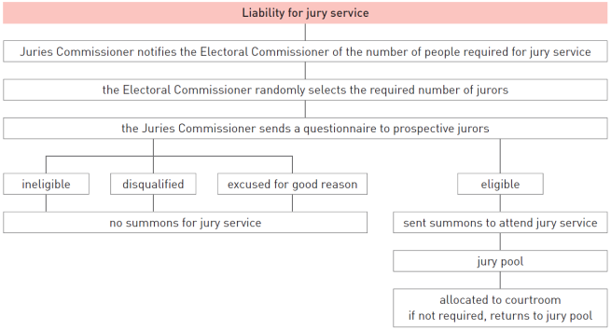
Composition of juries
If person deemed liable for jury service, will be summoned to attend court
Will form part of the jury pool for one to two days
Allocated to courtroom. If not required, return to jury pool

Slide 12
Empanelling the jury
Jurors are called into the courtroom one by one – name and number and, in some circumstances, occupation
Jurors walk to the jury box. One of the parties can decide the challenge the juror:
Challenge for cause – challenged for a reason (such as knowing the accused). Unlimited challenges for cause in criminal and civil trials
Peremptory challenges – challenged without a reason (usually based on an assumption)
Criminal trial – accused is allowed six peremptory challenges (less if more than one accused)
Civil trial – three peremptory challenges each
Prosecutor allowed to stand aside six jurors (must wait until the end of the challenging process.
If no more jurors left in the jury pool, they can take their place in the jury)
Once empanelled, jurors elect a foreperson to act as spokesperson

Slide 13
Strengths of the jury system
Cross-section of the people
Involves the general community
Spreads the responsibility
Reflects community values
Safeguards against misuse of power
Ensures less legal jargon
Tends to make the right decisions
Helps to protect democracy

Slide 14
Weaknesses of the jury system
Not a true cross-section of the community
Difficult task
Complicated evidence
Deliberations behind closed doors
Concentration for long periods
Unfamiliarity with legal procedure
Counsel could unduly influence a jury
Jurors could be biased
Jury is not required to give a reason
Delays
High cost
Difficulty of reaching a decision
Inconsistent damages (civil)

Slide 15
Reforms to the jury system
Reforms already made
Extra jurors
Majority verdicts
Jurors not allowed to make their own enquiries
Simplifying jury directions (Jury Directions Act 2013)
Suggested reforms
Require juries to give reasons for their decisions
Make juries more representative
Further simplifying jury directions
Specialist foreperson
Give instructions before the trial
Introduce ‘not proven’ verdicts
Juries to participate in sentencing
More technical assistance
Reduce the size of the jury

Slide 16
Possible alternatives to trial by jury
Judge alone
Panel of three judges
Professional jurors
Specialist jurors

Slide 17
Questions
Outline the process for the selection of a jury.
What reasons can you provide for some people being more likely to be chosen for jury service than others? What effect does this have on an individual’s right to be tried by their peers? Explain.
Explain how many challenges the accused is allowed in a criminal trial.
Why are the parties given the opportunity to challenge prospective jurors?
How may this affect the outcome of the trial from the point of view of the accused?
Explain the differences between the composition and selection of a civil and a criminal jury.
To what extent does the jury represent a true cross-section of the community?
Evaluate the statement ‘It is both a right and a privilege to participate in the jury system’.

