Slide 1
Roles and Responsibilities in the Courtroom

Slide 2
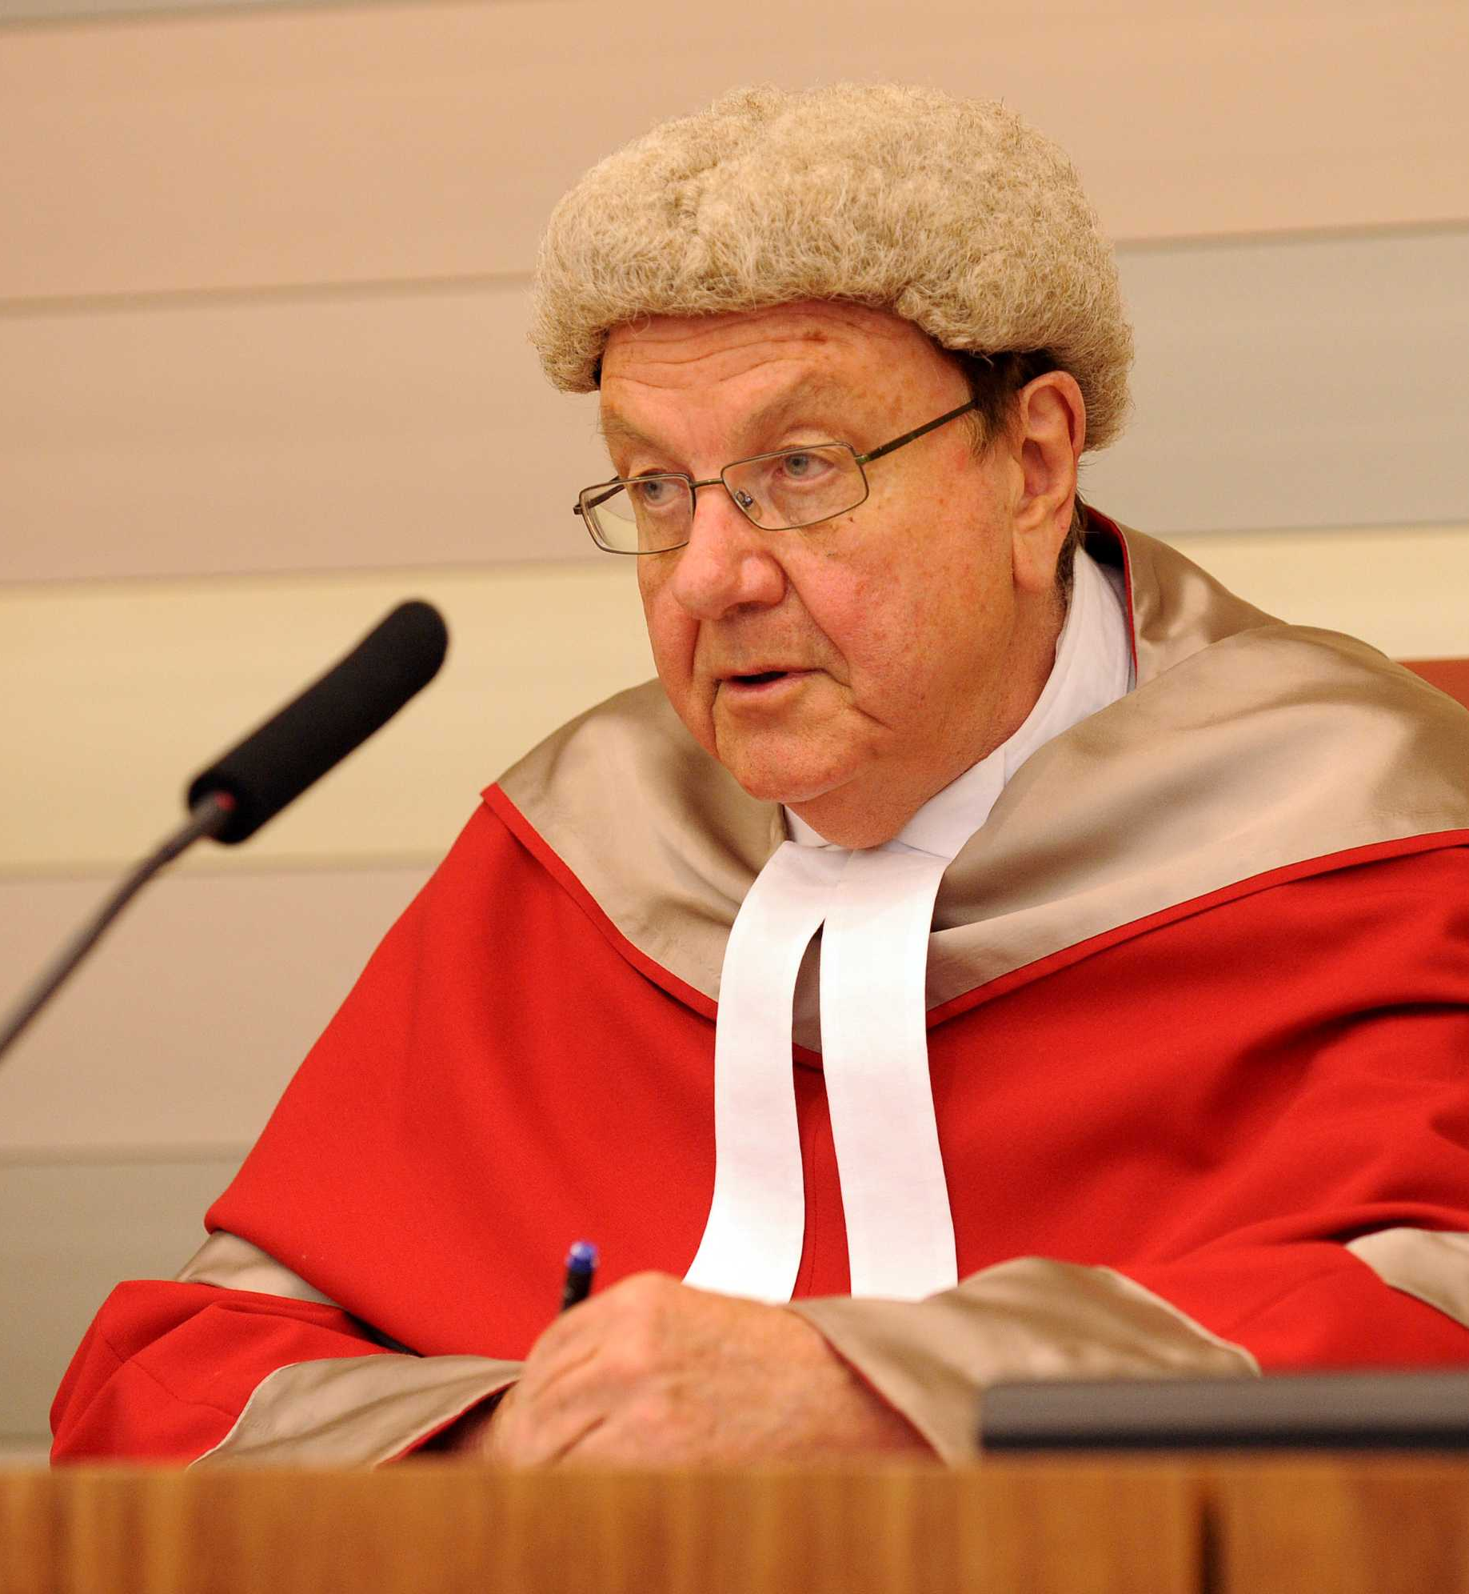
Judge The role of the judge is to be independent and impartial.
Manage the Trial
Ensuring correct procedure is followed
Give directions and make orders
Might ask questions for clarification
Deciding the admissibility of evidence
Attend to jury matters
Empanelment
Give directions to the jury and sum up the case
Hand down a sentence
Other duties:
Order that the VLA provide legal representation
Be familiar with technology
Be courteous and not interfere
Assist a self-represented party

Slide 3
Jury The jury listens to the evidence, considers the evidence and reaches a verdict.
Listens to all evidence and submissions presented by counsel for both sides
Remembers, collates and analyses arguments presented for both sides
Decides questions of fact
Follows instructions given by the judge on questions of evidence, procedure and points of law
Follows the judge’s direction, if issued, to acquit the accused
Takes note of the judge’s final summary of the case
Reaches and delivers a verdict.

Slide 4
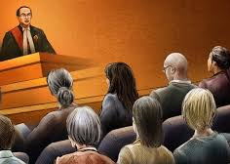
Role of the Judge when Jury are Present.
Explains which party has the burden of proof
Explains the standard of proof required
Applies the rules of evidence and procedure
Directs the jury as to the law that applies to the facts
Gives rulings on points of law when appropriate
Summarises the law that is applicable to the case
Answers questions from the jury.

Slide 5
The Parties and Legal Practitioners

Slide 6
The Parties in a Criminal Trial
Prosecution | Accused
Each party has control over the way the case will be run but must always comply with their responsibilities and the court’s rules, directions and orders (party control)
In a criminal case, the accused and the prosecutor are responsible for presenting the relevant facts to support their case
The Office of Public Prosecutions prepares and conducts prosecutions for the DPP

Slide 7
Responsibilities of the parties
Give an opening address
Assist the judge in jury matters (empannelling)
Present the party’s case
Give a closing address
Make submissions about sentencing
Other responsibilities:
Attend trial
Research the law
No bias

Slide 8
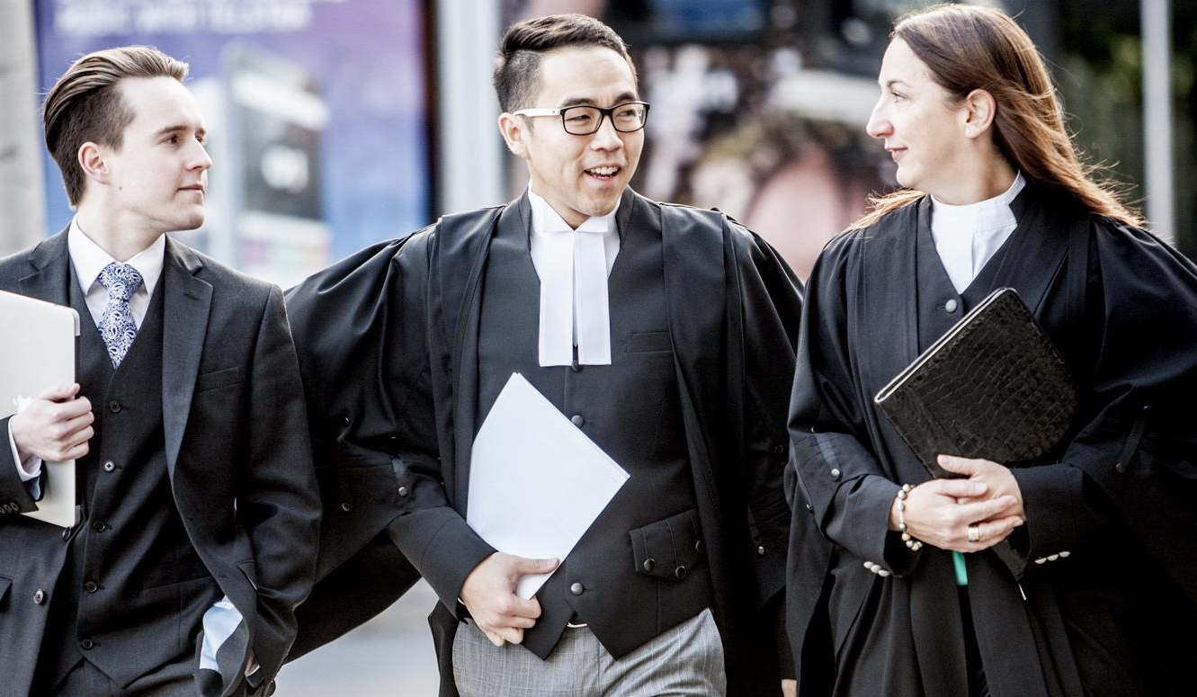
The legal Practitioners Legal representatives prepare and present the case for the parties.
A solicitor will provide advice and will prepare the case (a ‘brief’) for a barrister.
The barrister is a member of the Bar and will present the case in court.

Slide 9
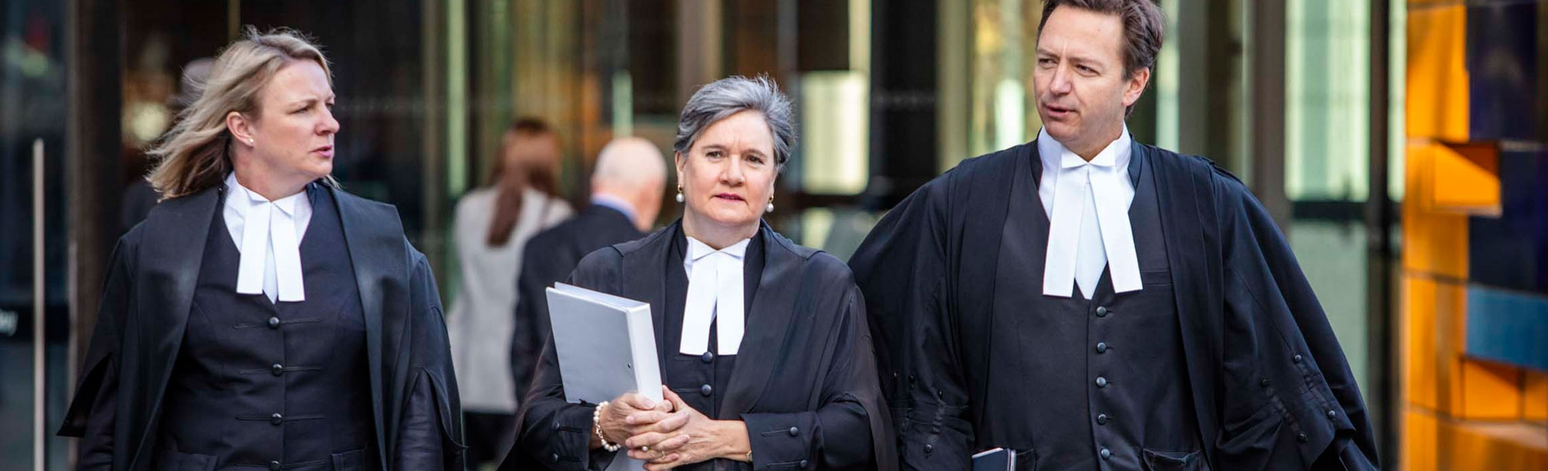
Responsibilities of the Legal Practitioners
Be prepared
Assist in finding the truth and not mislead the court
Comply with their duty to the court
Act in the best interests of their client
Other responsibilities:
Advise the accused about their rights
Defend the accused irrespective of any belief or opinion

